Slide 1
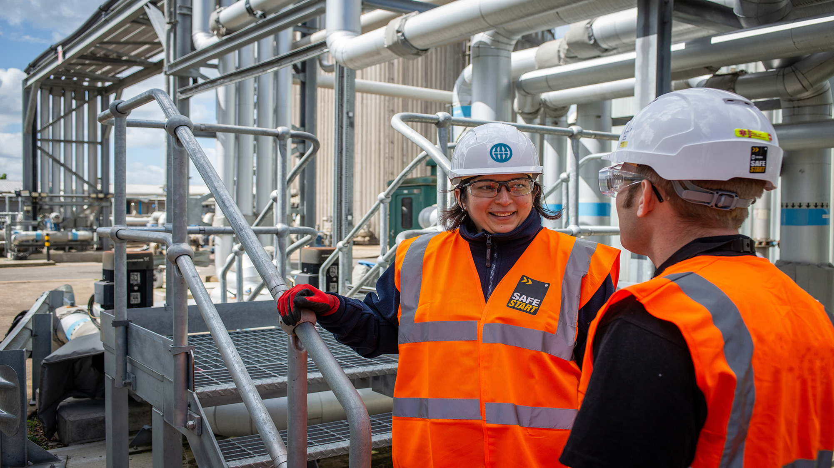
Slips, Trips and Falls
July 2021

Slide 2

Slips, Trips and Falls
Slips, Trips and Fall are one of the most common incidents occurring on our sites
Many can be eliminated by taking extra care when in certain situations
Good housekeeping also helps eliminate slip and trip hazards
We must prevent slips, trips and falls if we want to achieve our goal of a Injury Free Environment

Slide 3

Steps to Follow
7 SIMPLE STEPS FOR YOU TO FOLLOW
Notes:
The next seven slides summarise the key points.
It’s recommended that you spend a few moments on each slide asking your team what specific risks you face on your site and discussing how you can overcome them. Make sure someone is taking notes so you can capture action points.

Slide 4

Step 1
TAKE CARE STEPPING OUT OF YOUR VEHICLE
Notes:
Suggested Talking Points:
- What specific slips, trips and falls risks do we face on our site when stepping out of vehicles? Include plant equipment being used on site.
- What can we do to prevent this?

Slide 5

Step 2
STAY FOCUSED FIRST THING
Notes:
Suggested talking points:
- What activities do we carry out ‘first thing’ which carry a risk of slips, trips and falls?
- How can we take extra care when performing these activities first thing?
- How can we keep our focus all day?
- Is there a way we can completely remove the risk in the activity?

Slide 6

Step 3
TAKE EXTRA CARE WHEN IT’S SLIPPERY, WET or ICY
Notes:
Suggested talking points:
- Which activities would be most at risk when it’s slippery and wet on our site?
- How can we take extra care?
Is there a way we can prevent these areas from getting wet, slippery or icy?
What weather conditions would contribute to slippery conditions?
Do we need to grit our walkways?

Slide 7
Step 4
CHOOSE YOUR ROUTE
Notes:
Suggested talking points:
- Do we all know what the site safe routes are?
Have we recently reviewed these? Are they still safe?
Has anyone identified any problems?
- What risks are there while walking around our sites?
- Are we practicing good housekeeping? What could we do better?

Slide 8
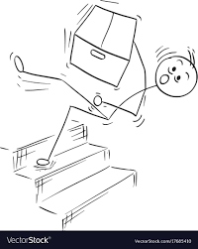
Step 5
ALWAYS USE THE HANDRAIL
Notes:
Suggested talking points:
- Where are there risks of slips, trips and falls on stairs or staircases?
- Are there appropriate handrails or does action need to be taken?
Can we all commit to using the handrail and can we agree to remind each other and not ‘walk on by’
Do we use the phone while using the stairs?
Do we need to carry large items up or down stairs?

Slide 9
Step 6
DON’T
WALK AND TALK!
Notes:
Suggested talking points:
- Why is walking and talking dangerous?
- When might this happen (e.g. while on a mobile; while speaking to a colleague)
- What can we do to stop this from happening
- Can we all agree to look out for this happening and take steps to help stop incidents?
- What are the rules on this site regarding use of mobile phones?

Slide 10
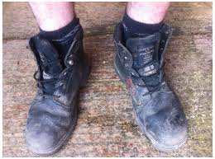
Step 7
DO THEM UP
“Support your FEET & they will Support you”
Notes:
Suggested talking points:
- Is your footwear safe?
Are you laces tied securely?
Discuss side zip boots, do they become loose over time?
- Do you have a good depth of tread?
- Does anyone need to flag any risks?

Slide 11
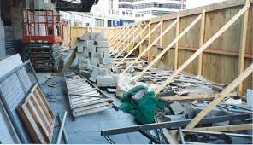
Walkways & Pedestrian Routes
The majority of trips are caused by obstructions in walkways
The rest are caused by uneven surfaces
What can we do on our site to make our walkways safer?
Notes:
Suggested speaker notes:
“The majority of trips are caused by obstructions in walkways. The rest are caused by uneven surfaces. Preventing these accidents is often simple and cost-effective.”
Suggested Discussion – ask your team:
“Are our walkways suitable? Are they in the right place? Are they being used by everyone? Is the lighting sufficient?
“What tasks are taking place on the walkway? Is the task preventing someone from using the walkway safely? Is the person carrying out the task at risk?”

Slide 12
Housekeeping
Are our walkways clear?
What obstructions are trips waiting to happen?
Do you make safety personal and practice good housekeeping by adopting a great cleaning regime?
Are there enough bins/storage to support this?
What else can we do to make a positive difference on our site?
Notes:
Suggested speaker notes:
“It’s not enough just to have walkways – they must be clear of obstructions. Our site generally must be clean and clear – it’s our shop window and it’s our place of work. We can all take personal responsibility for practicing good housekeeping and cleaning up as we go, removing obstacles and thinking about how what we do and how we work could cause a hazard for our team mates.”
Suggested Discussion – ask your team:
“Where do we see problem areas on our site? How can we change this?
“Do we have the right facilities to store things? What’s missing?”

Slide 13
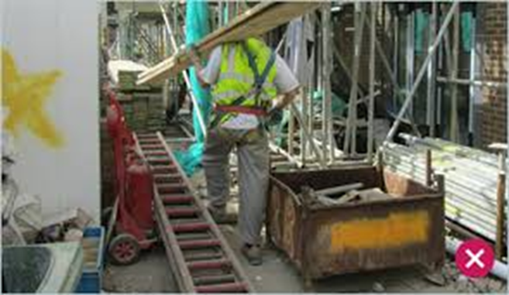
Design and Maintenance
Is our site designed to help prevent slips, trips and falls?
Does your daily routine regularly put you at risk?
Do we know our danger areas such as uneven surfaces?
Where can we make it safer by changing things?
Notes:
Suggested discussion notes:
“Is there anything we can do to make our site safer by changing the design and the way we maintain it? There’s some things to consider on the slide…”

Slide 14
Final Thoughts…
If you see slip and trips risks, try and sort them out or inform your supervisor or manager
Don’t walk by – take positive action to improve things and reduce risks
Practice great housekeeping
Keep your work place clear of obstacles
Ensure any observations are reported to supervisor or manager
Look after yourself and your work mates
Notes:
Suggested Close:
- Thank everyone for contributing to the briefing
- Summarise the key points by reading the bullets on the slide
- Remind everyone of any key actions that came out of your discussions and the next steps you’ll take with these.
- Ask if there’s any questions
- Remind everyone to take extra care as they return to work.

Slide 15

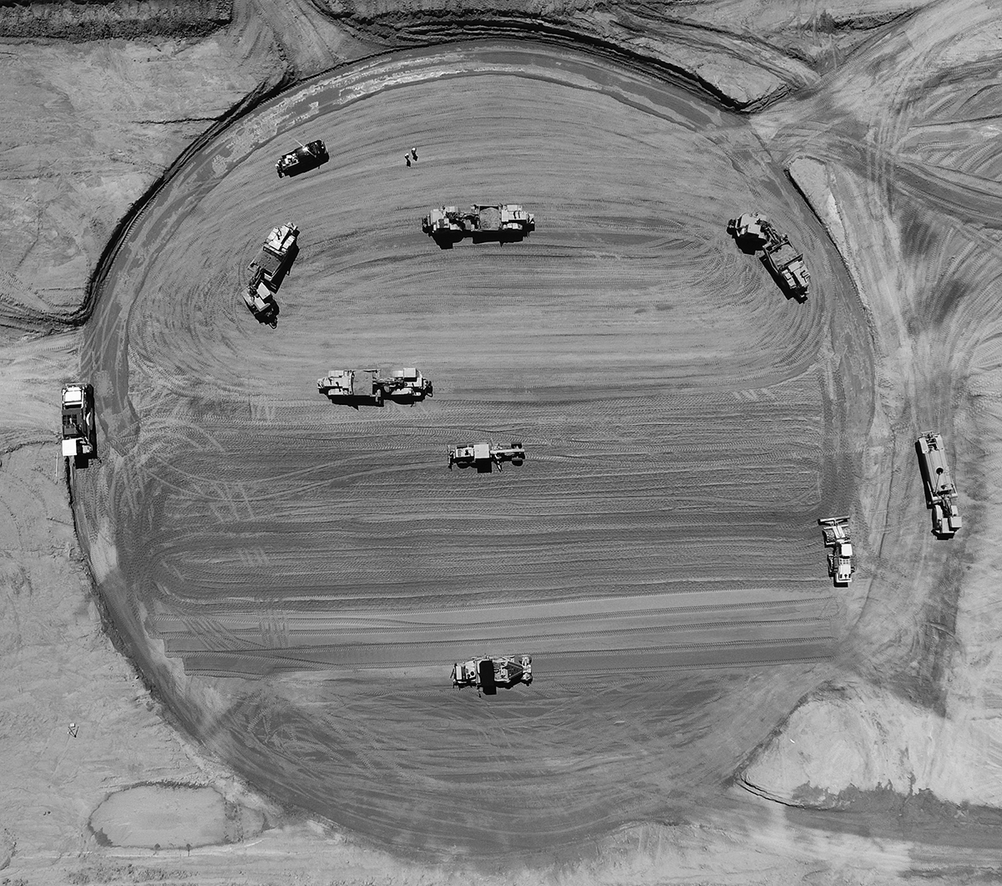
Thanks for
your time.

