Slide 1

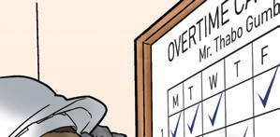
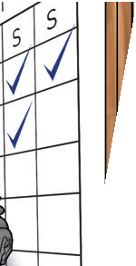
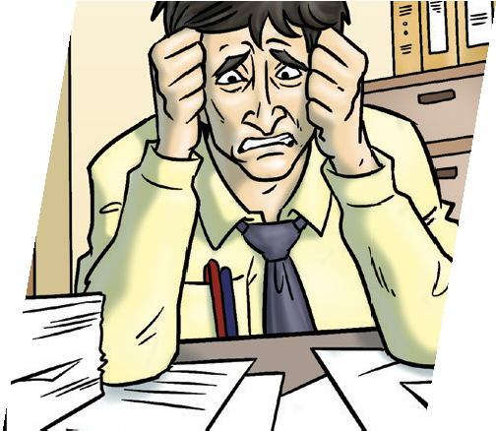
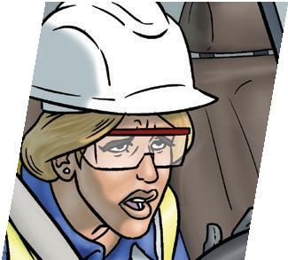
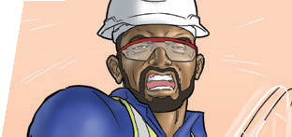
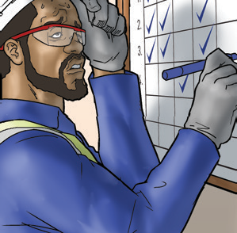
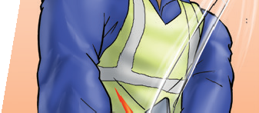

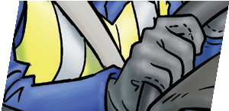
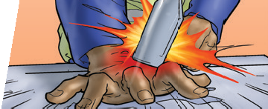


Theme of the month – September 2021
MANAGING FATIGUE IN THE WORKPLACE
Fatigue and me
Fatigue isn’t simply feeling sleepy or tired.
It is a decrease in mental
and physical health and performance. This means it affects our moods, how we think, specifically about risk, and how we behave.
Me
Poor mental health
Less able to cope with stress and strain
Decrease in physical wellbeing; increased risk of diabetes (type 2) and heart disease
The effects of fatigue on:
My friends and family
A lack of energy to maintain relationships and friendships
Less motivation to socialise
They will grow tired of my irritability
My work
Slow reactions and poor judgement
Underperformance and lack of concentration
Increase in the risk of injury or incidents
My work colleagues
May not feel safe working around or with me
Don’t trust me or treat me as part of the team
May feel that I’m not ‘pulling my weight’
My employer
Doesn’t think I’m fit for work
Could be bad for company’s reputation if I cause accidents
May think I’m using my rest time for other paid work
Page | 1 of 3
Revision 1
September 2021

Slide 2




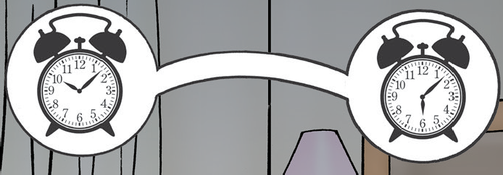

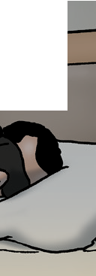
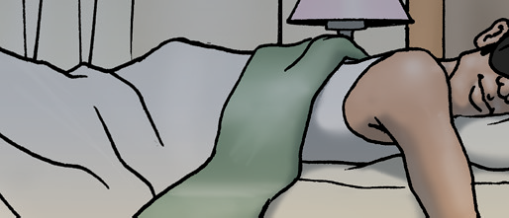
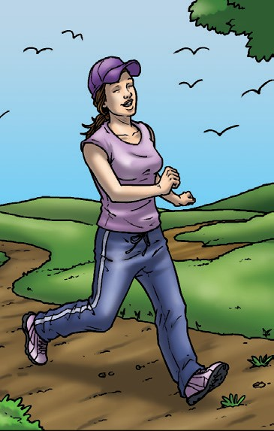
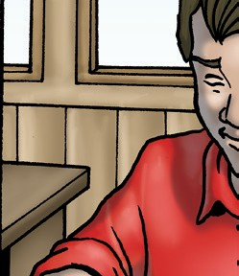
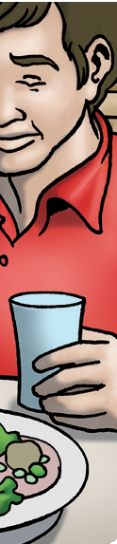
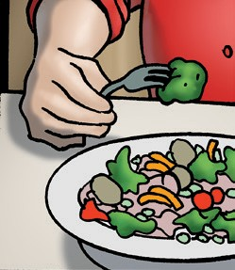
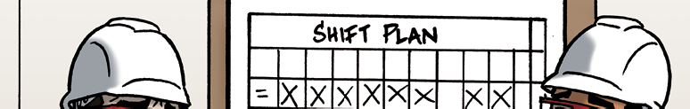
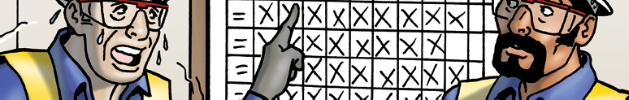

Employer responsibilities:
Theme of the month – September 2021
MANAGING FATIGUE IN THE WORKPLACE
Communicate the fatigue management action plan to employees
Offer a health assessment for night shift workers
11hrs
Ensure employees have 11 hours rest between shifts / per 24 hours
Provide information, training and education on fatigue
60hrs/w
Not make employees work more than 60 hours a week
Consider fatigue in all incidents / accidents and report it
If extra work is needed, assess individual employees for fatigue
It’s a shared responsibility between employees and MWHT to manage fatigue.
My responsibilities:
Be fit and well rested
Be a responsible driver
Try to get a minimum of 7 hours sleep each night
Look after myself and others
Tell my manager / supervisor if I feel fatigued
Take note of information to prevent and fight fatigue
Illnesses
do I feel well enough before my shift starts?
Medication
am I taking any medication that makes me feel drowsy?
Think “I’M SAFE”
Stressed/emotional
– am I feeling especially stressed or upset today? Do I need to speak to someone before going on my shift?
Alcohol
– could there still be alcohol in my system?
Remember, it can take at least 1 hour to
process 1 unit of alcohol.
Fatigue
– have you had restricted sleep? Did you rest since your last shift? Are you having trouble keeping your eyes open or concentrating?
Eaten
– have you had something to eat and drink?
September 2021
Page | 2 of 3
Revision 1

Slide 3

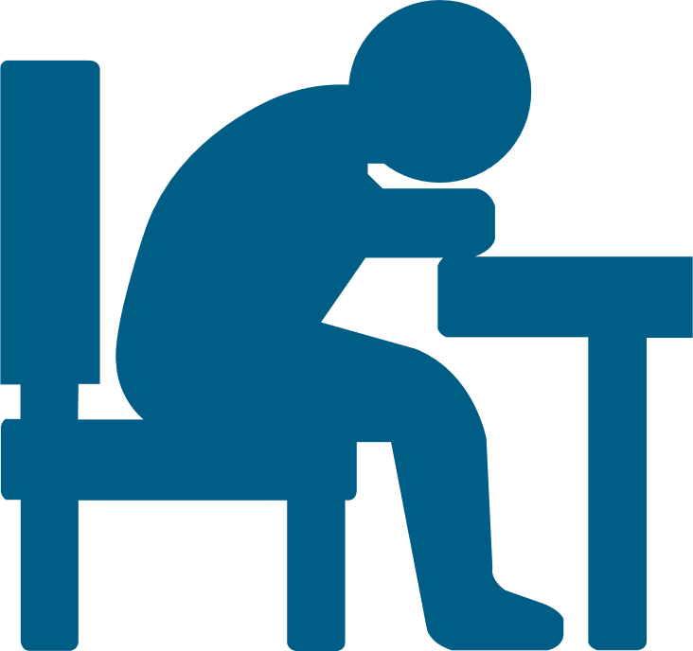
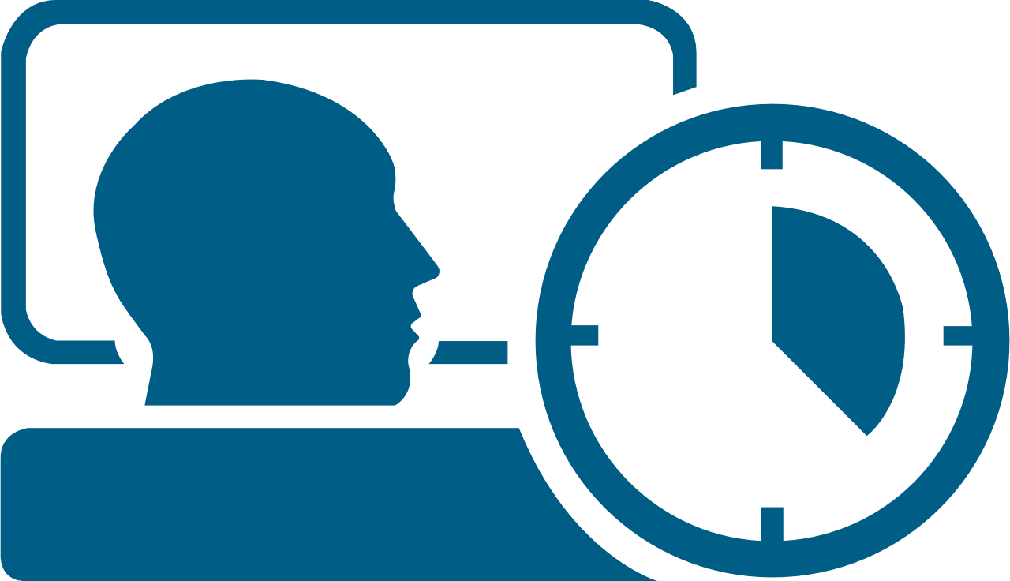



Theme of the month – September 2021
MANAGING FATIGUE IN THE WORKPLACE
Are you awake enough for work?
complete the short assessment below to identify if you may be suffering from fatigue.
Fitness For Work
What does it mean?
Do you believe you’re fit for work?
No
Yes, but need extra controls
Yes
If one or more of your answer is Red, your fatigue category is
Severe.
Current Fatigue State
z
z
How do you feel right now?
z
Very fatigued, difficulty staying alert
A bit tired, effort to stay awake
Very Alert – wide awake
If one or more of your answer is Amber, your fatigue category is Moderate.
Sleep Quantity
Have you slept in the last 24 hours?
No
Yes – but less than 7 hours
Yes – more than 7 hours
Otherwise if your answers are all Green, your fatigue category is Mild.
Sleep Quality
Rate the quality of your sleep:
Poor
Average
Good
Signs of Fatigue
If your fatigue category is Severe or Moderate, you must talk to your manager about next steps…
Have you experienced any physical (e.g. microsleeps) or mental signs (e.g. difficulty concentrating) of fatigue immediately prior to or during this shift?
Yes |  | No
September 2021
Page | 3 of 3
Revision 1

