Slide 1
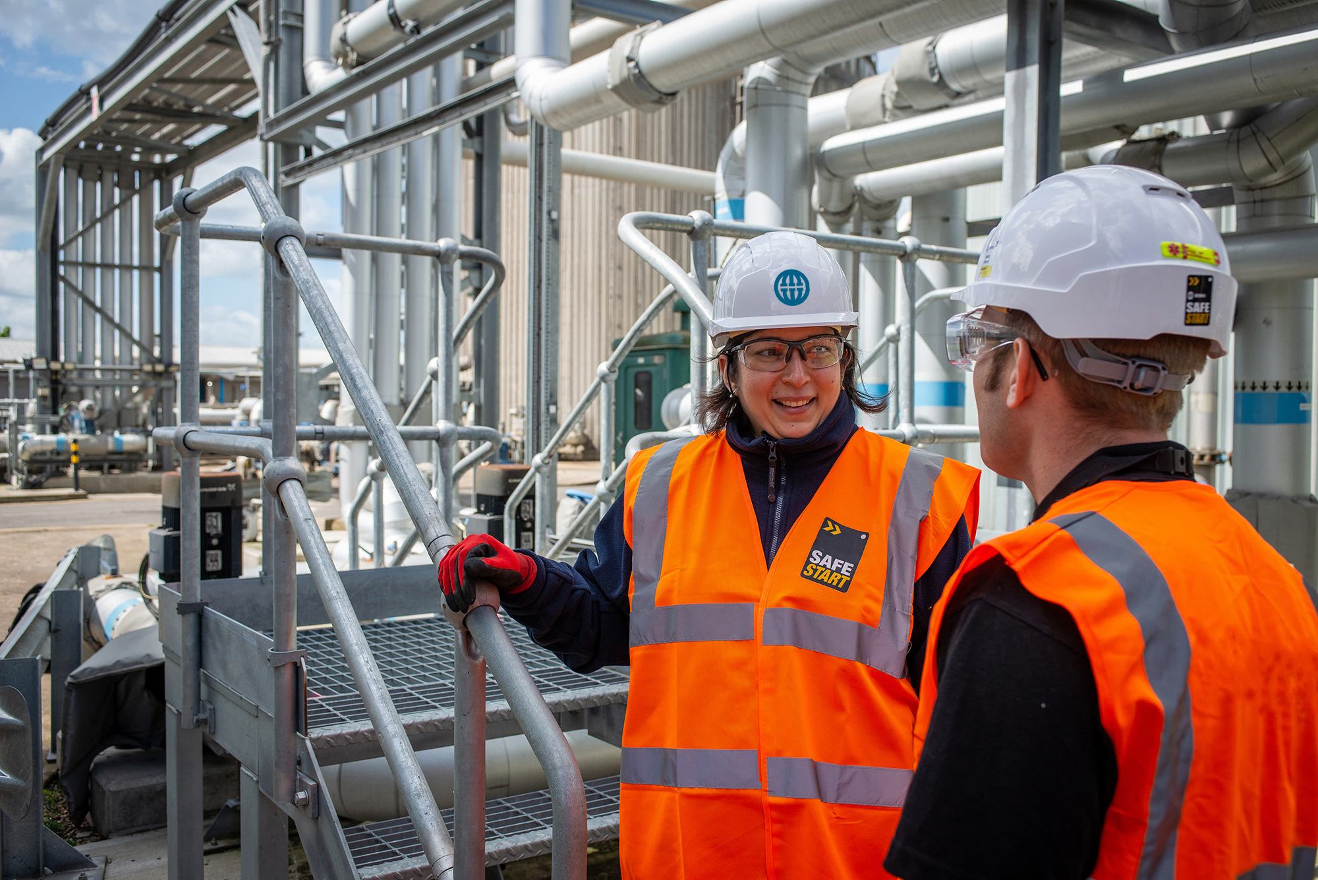

Tiredness, Fatigue, Rest and Recovery
Notes:
Simon C

Slide 2
Tiredness, Fatigue, Rest and Recovery
What we’re doing ?
We are focussing this month on “Tiredness, Fatigue, Rest & Recovery”. Our state of tiredness and fatigue is a contributor to our wellbeing and performance. Effective recovery is essential to avoid fatigue and is as important for office based staff as it is for site staff whom may be taking on more physical work.
Why we’re doing it ?
Tiredness and Fatigue can act as hazards in themselves, and we have a duty to ourselves and work colleagues to be as fit for purpose as we can be as we undertake our daily activities. Understanding how to properly recover from mental and physical tiredness can help us avoid fatigue and ensure we are energised inside and outside of our work life.
Who is it for ?
As always – all our staff irrespective of role or work location. Whilst we are all accustomed to identifying physical tiredness and fatigue, mental tiredness and fatigue is less obvious and can require longer and more specific methods of recovery.
What Else ?
Work fatigue needs to be managed, like any other hazard. Managing our own recovery is one thing but noticing the signs of fatigue in colleagues and helping with their effective recovery ties us together as a team and will help us perform better as an enterprise. Sharing the load is an effective way to preventing individuals getting fatigued, [but is reliant on developing skills knowledge and experience, and having motivated staff and teams.]
Notes:
Simon C

Slide 3
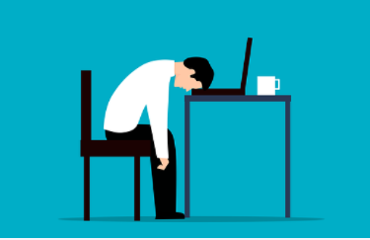
Tiredness and Fatigue
What is the difference?
We all experience tiredness at times which can be caused by a hectic work or personal schedule, an eventful day, activity or even a poor diet and lifestyle choices which can generally be relieved by sleep and rest. If you don’t get enough sleep, you are likely to feel tired. This kind of tiredness usually subsides on its own when you go back to sleep and get adequate rest, and you awake feeling re-energised.
Fatigue is when the tiredness is often overwhelming and isn't relieved by sleep and rest. If you are getting enough rest and still feeling tired all the time, then it is not tiredness, but fatigue. Fatigue can be a more complex issue which a variety of symptoms, such as:
Difficulty concentrating
Low stamina
Difficulty sleeping
Anxiety
Low motivation
These symptoms may sound similar to those of tiredness but they usually last longer and are more intense.
You can’t cure fatigue easily just by having a cup of coffee or by resting. Fatigue can be long-term and can make you feel exhausted even after a full night’s sleep. Depending on the severity of fatigue, it may affect a person’s everyday life.
Notes:
Simon C

Slide 4
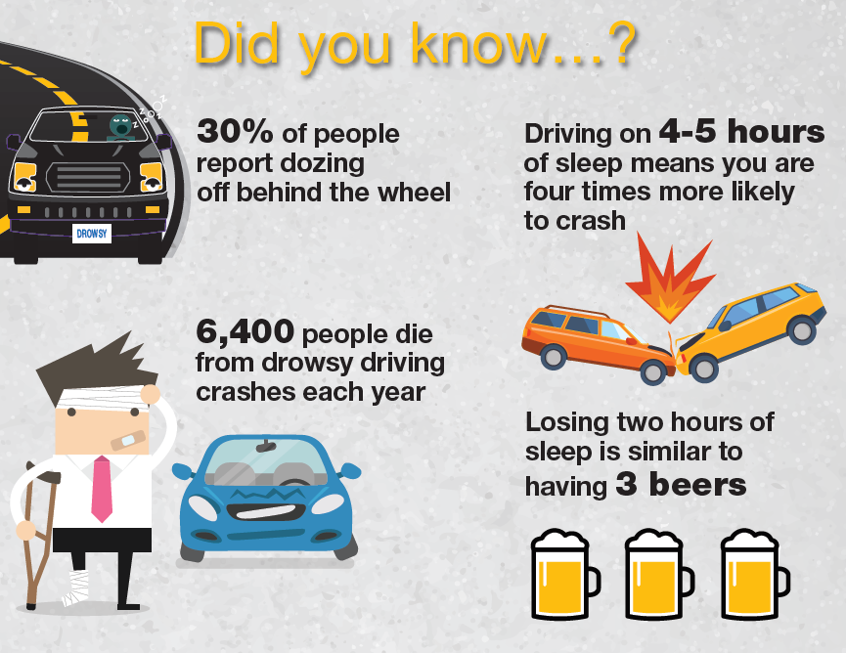
Driving and Tiredness
Notes:
Simon C

Slide 5
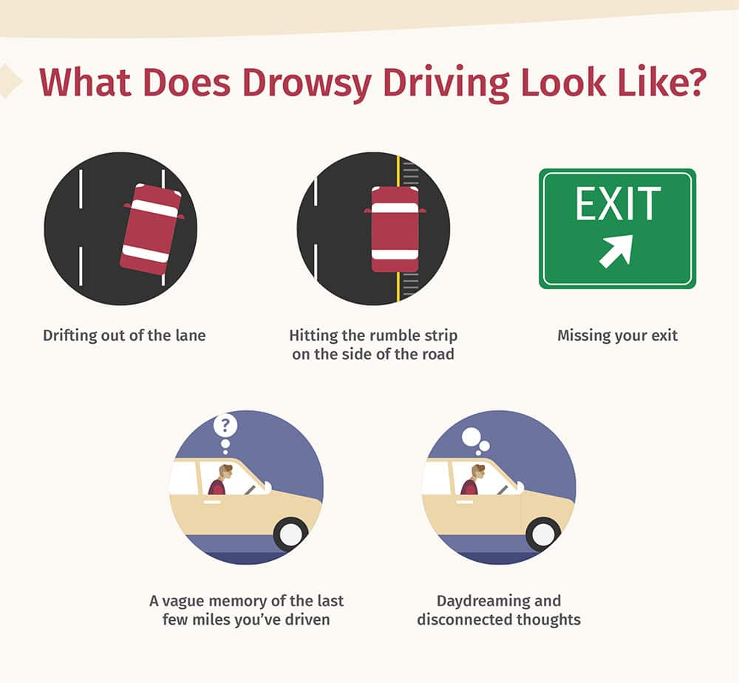
Driving and Tiredness
Tired drivers can;
Have impaired judgement through slow reaction times and slow decision making times, neither of which contribute to good driving, and exposes us to a higher risk of an accident.
Fall asleep at the wheel, the implications of which could be fatal, to yourself and third parties…
Avoid driving when tired… Top Tips…
Get a good night's sleep, start your journey as refreshed as possible.
Avoid driving at night when your body will naturally want to sleep.
Try and arrange to share the driving.
Avoid long drives after work.
Plan to take regular breaks from driving, if you feel drowsy at the wheel take a break at your very earliest opportunity.
Try and utilise public transport, when & where it is convenient.
Ask someone for a lift, [or offer a lift] if you know someone travelling in your direction.
Notes:
Simon C

Slide 6
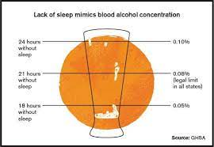
Work Fatigue
In the context of occupational health and safety, fatigue refers to mental or physical exhaustion that reduces someone’s capacity to perform work safely and effectively. Fatigue doesn't just cause workers to feel more tired - it also increases the rate of accidents and injuries, reduces productivity, and causes absenteeism.
Fatigue is more than just feeling tired. In fact, research shows that spending 18 hours awake is equivalent to having a blood alcohol content of 0.05, while 24 to 25 hours is equivalent to a BAC of 0.10. You would never let an employee operate heavy machinery with that much alcohol in their system, yet fatigued workers routinely engage in difficult or hazard-heavy work.
Notes:
Simon C

Slide 7
Work Fatigue
Fatigued workers can put themselves or others at risk, so it's important for managers and supervisors to know the signs of fatigue. Here are some of the key things to watch out for:
Tiredness, Weariness, or Sleepiness
Irritability
Reduced Alertness, Concentration, or Memory
Lack of Motivation
Increased Mistakes or Lapses in Judgment
Headaches
Increased Susceptibility to Illness
Fatigue results in
slower reactions
reduced ability to process information
memory lapses
absent-mindedness
decreased awareness
lack of attention
underestimation of risk
reduced coordination etc.
Notes:
Simon C

Slide 8

Work Fatigue
Fatigue can also be caused by ongoing health problems, which need to be addressed by a healthcare specialist - if symptoms persist for a prolonged period or you have any concerns, please contact your GP. These can include anaemia, sleep apnoea, underactive thyroid, coeliac disease, diabetes, MS and depression.
See the NHS website for more information - Sleep and tiredness - NHS (www.nhs.uk)
If any health concerns have been ruled out, there are ways to help yourself reduce Work Fatigue:
Maintain work/life balance - a well-rested and energized worker, both physically and mentally, is far more valuable than an overworked person.
Take care of your health – eat well, take some exercise and stay hydrated.
Plan your schedule – are you a morning or afternoon person? Try to plan your day around when you are most productive.
Get a good nights sleep – sleep deprivation impacts your energy levels, cognitive functions, and motivation, which can quickly turn into general fatigue, affecting your work performance as well.
Remember to take regular breaks and annual leave – this will help you maintain focus, and relax.
Notes:
Simon C

Slide 9

Getting a Good Nights Sleep
A good night’s rest is essential to a healthy existence, protecting you physically and mentally as well as boosting your quality of life.
If you have difficulty falling asleep, a regular bedtime routine will help you wind down and prepare for bed.
Few people manage to stick to strict bedtime routines. This is not much of a problem for most people, but for people with insomnia, irregular sleeping hours are unhelpful. Your routine depends on what works for you, but the most important thing is working out a routine and sticking to it.
Try to go to sleep at regular times
Make sure you wind down before bedtime
Make your bedroom sleep-friendly – create the right environment
Make sure you are comfortable (mattress, pillows, warmth etc)
Prepare for a good nights sleep (control exposure to light/screens etc)
Take exercise at least 2 hours before bedtime if you can
Avoid caffeine, alcohol and heavy food before bed.
See our Wellbeing & Benefits Connect page for more resources on better sleep
Notes:
Simon C

Slide 10
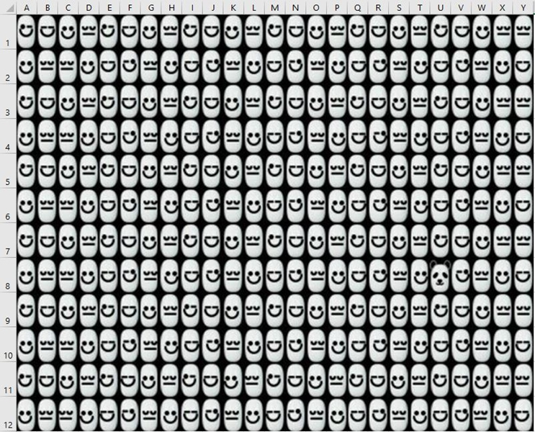
Are you tired?
QUIZES
Find the Panda – Observation & Alertness – how quickly can you find the panda in the matrix? Try it as a team and compare your results.
Notes:
Simon C

Slide 11

Are you tired?
QUIZES
Psychology Today: Mental Speed Test
Notes:
Simon C

